Slide 1
ForEach Workflow Task
Databricks

Slide 2
Workflow:
Workflow is a fully managed orchestration services integrated with Databricks platform. Workflow job is combination of Tasks, Cluster, Schedule.
Tasks like running notebook, sql file or DLT pipeline by maintaining dependencies etc., simply like what to run or execute in which manner
Cluster : defines how do you execute it like either using Job cluster or interactive or serverless
Schedule : When to schedule
In this PPT we will learn how to pass the values from one task to another task , how to make job or workflow dynamically

Slide 3
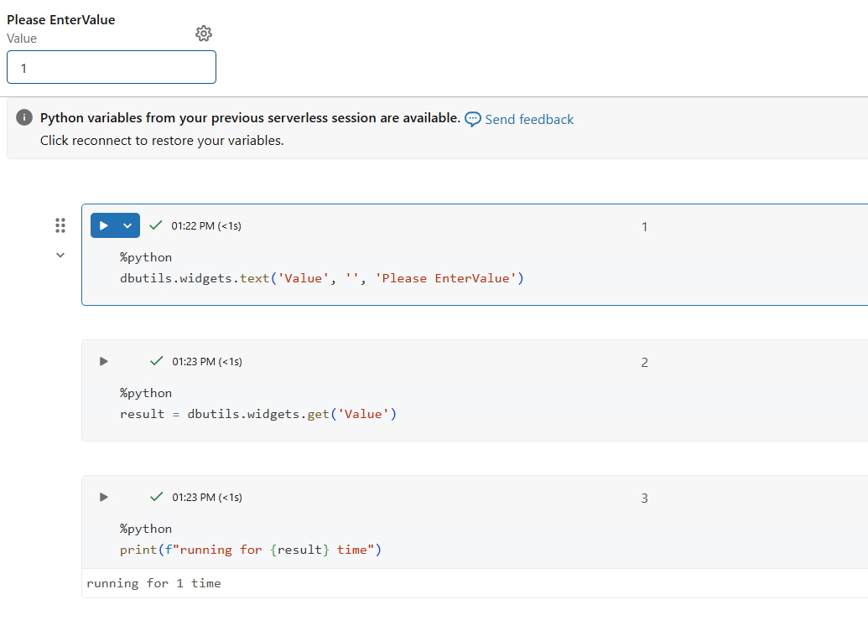
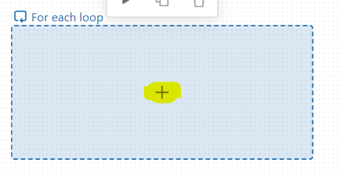
For each Task Sample Demonstration:
Let’s create a For each task in databricks workflow . For each task required input as always List.
Say we have a simple notebook and we need to iterate that notebook for N of times. + Symbol is used to add another task inside of it for each.
Sampel code in the notebook looks like in 2 img, Using widgets and passing the values for the widgets from the job

Slide 4
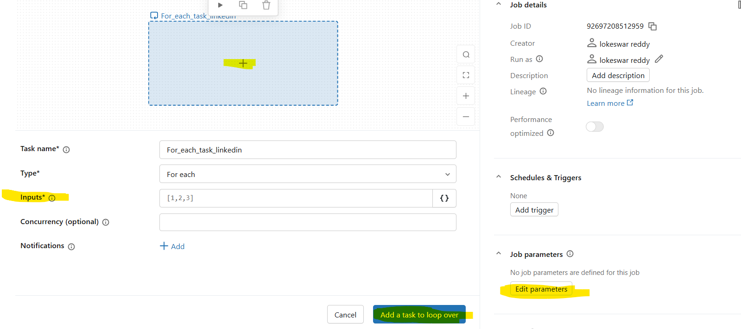
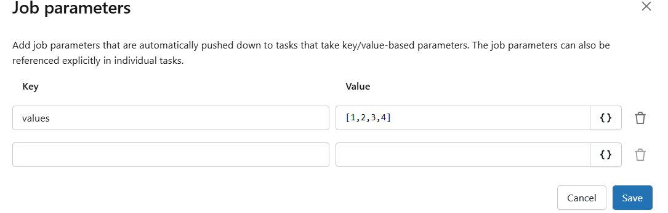
Continue….
Lets create a job parameters and pass it in the input tab for the for-each task
Pass to input by clicking {}

Slide 5
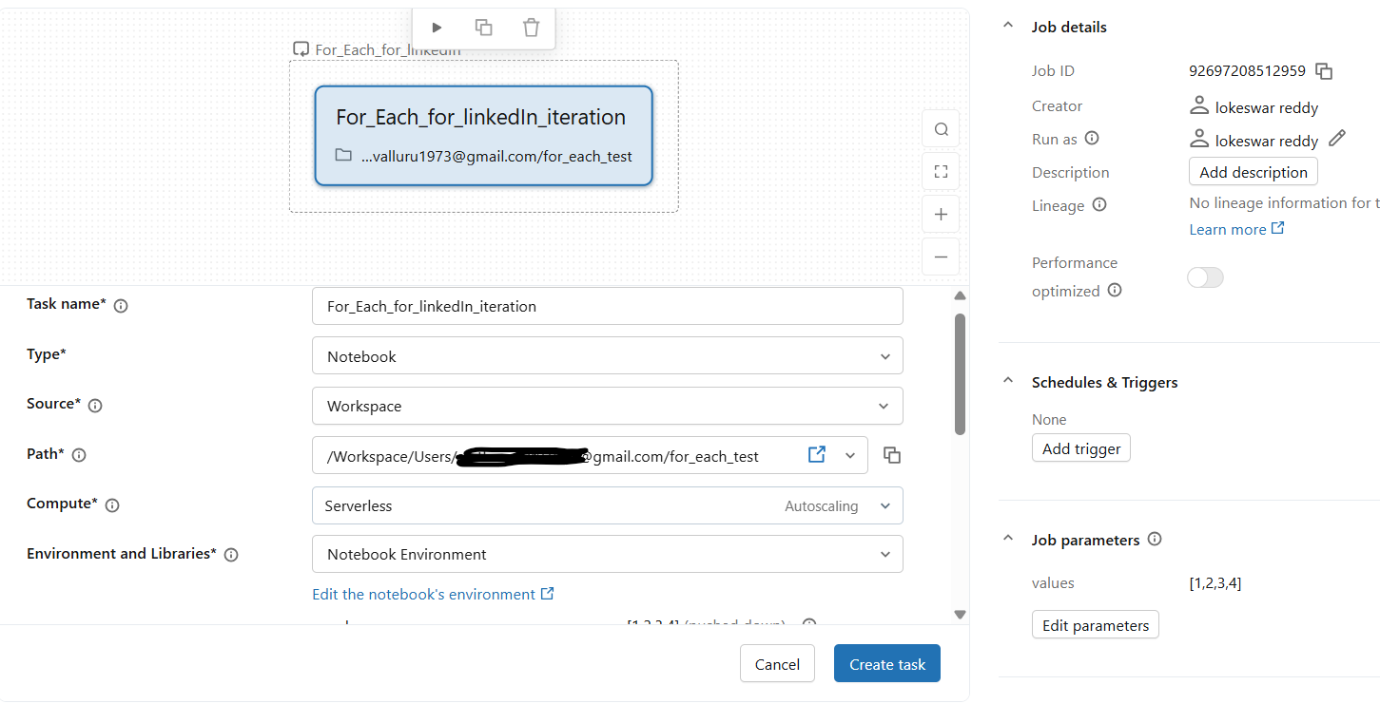
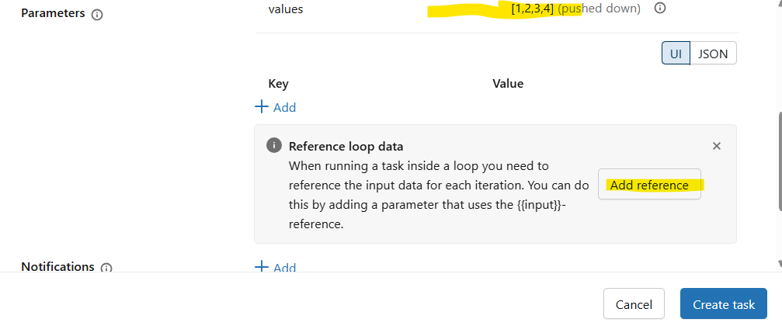
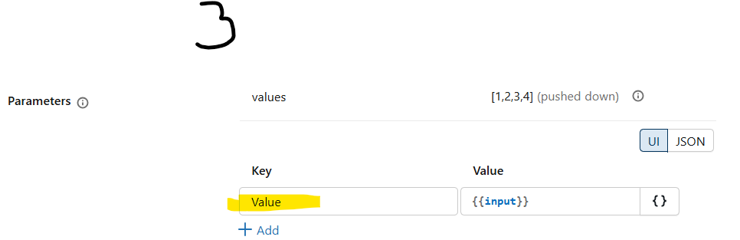
Continue…
Now lets add Notebook task inside of it and parameters. Note the Key of parameter should be same a Widget name provided in the notebook.
Add refernence

Slide 6
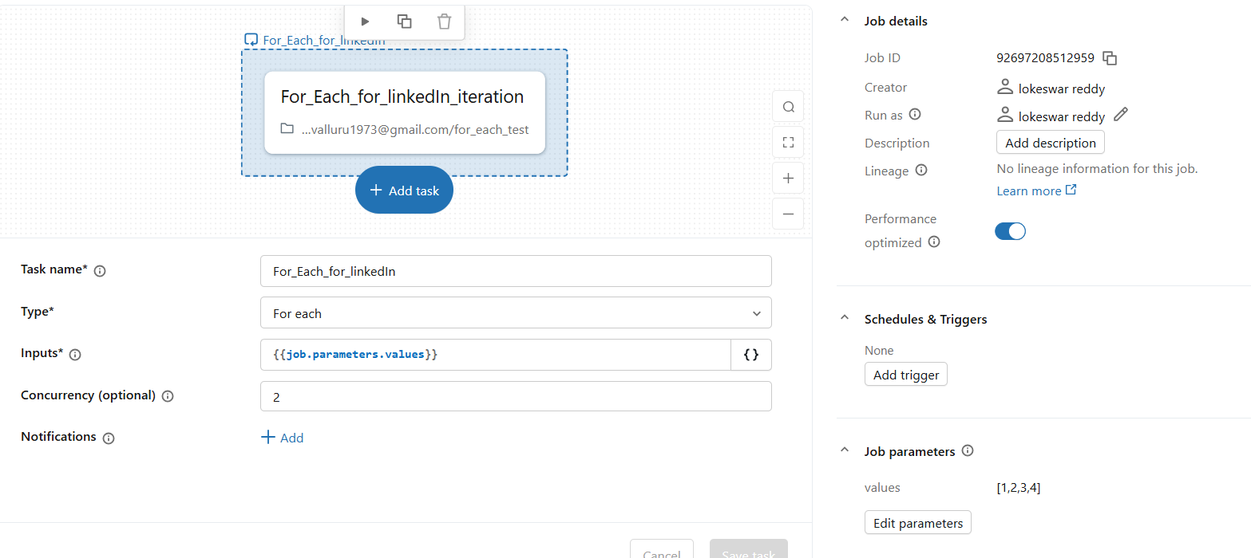
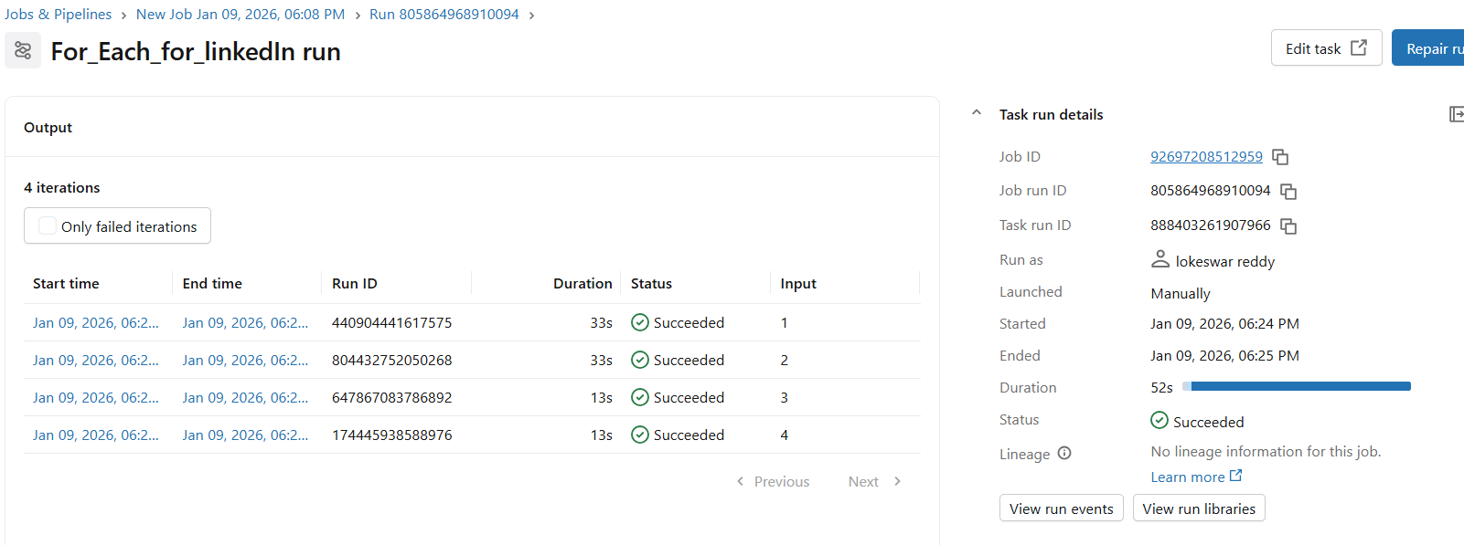
Continue…
Final picture . Here by default concurrency is 1. Change to 2 for example. So that two task will run at a time (notebook task consider two input values at a time)

